Slide 1
Logic Gates
Logic gates are simple digital circuits that take one or more binary inputs and produce a binary output
A logic symbol is a graphical representation of the circuit that can be used in a schematic to show how circuits in a system interface to one another.
Inputs are usually drawn on the left (or top) and outputs on the right (or bottom).
Digital designers typically use letters near the beginning of the alphabet for gate inputs and the letter Y for the gate output.
The relationship between the inputs and the output can be described with a truth table or a Boolean equation.
A truth table lists inputs on the left and the corresponding output on the right.
It has one row for each possible combination of inputs. (If a logic circuit has n inputs, then it will have 2^{n} possible input codes.)

Slide 2
Logic Gates
A logic expression (also called a logic function), is an equation that provides the functionality of each output in the circuit as a function of the inputs. The logic operations for the basic gates are given a symbolic set of operators
A logic waveform is a graphical depiction of the relationship of the output to the inputs with respect to time.

Slide 3
Logic Gates
Perform logic functions:
inversion (NOT), AND, OR, NAND, NOR, etc.
Single-input:
NOT gate, buffer
Two-input:
AND, OR, XOR, NAND, NOR, XNOR
Multiple-input

Slide 4
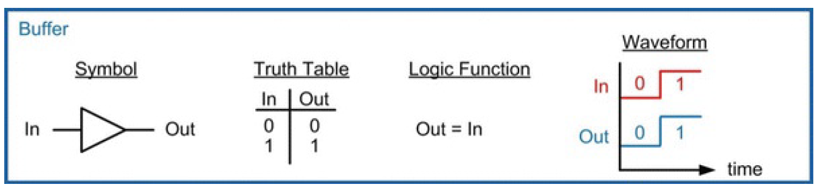
Buffer
It simply copies the input to the output.
From the logical point of view, a buffer is no different from a wire, so it might seem useless.
However, from the analog point of view, the buffer might have desirable characteristics, such as the ability to deliver large amounts of current to a motor or the ability to quickly send its output to many gates.
This is an example of why we need to consider multiple levels of abstraction to fully understand a system; the digital abstraction hides the real purpose of a buffer.

Slide 5
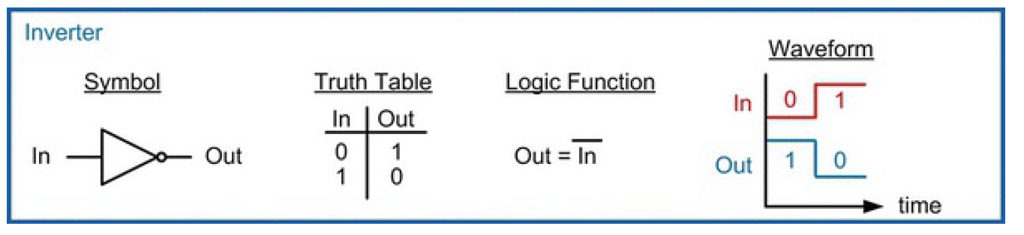
Inverter (NOT Gate)
A NOT gate has one input, A, and one output, Y
The NOT gate’s output is the inverse of its input. If A is FALSE, then Y is TRUE. If A is TRUE, then Y is FALSE.
The line over A in the Boolean equation is pronounced NOT, so Y = A is read “Y equals NOT A.” The NOT gate is also called an inverter.
Other texts use a variety of notations for NOT, including Y = A′, Y = ¬A, Y = !A, or Y = ~A.

Slide 6
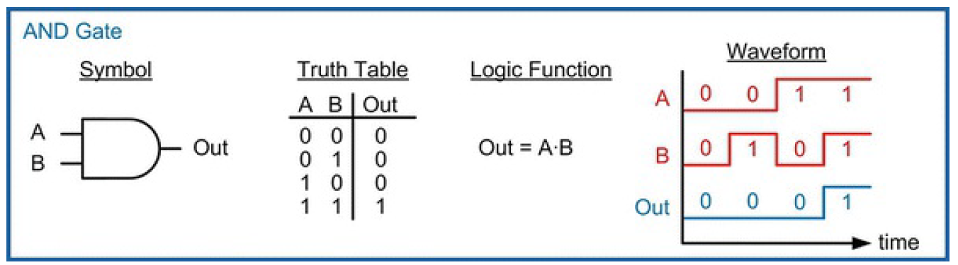
AND GATE (logical product)
The AND gate produces a TRUE output, Y, if and only if both A and B are TRUE. Otherwise, the output is FALSE.
This operation is also called a logical product because if the inputs were multiplied together, the only time the output would be a 1 is if each and every input was a 1.

Slide 7
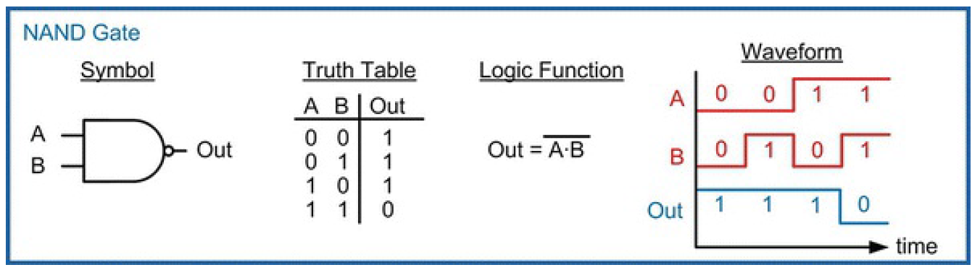
NAND Gate
“N” in NAND stands for “NOT”, which represents the inversion
The symbol for a NAND gate is an AND gate with an inversion bubble on the output.
The logic expression for a NAND gate is the same as an AND gate, but with an inversion bar over the entire operation

Slide 8
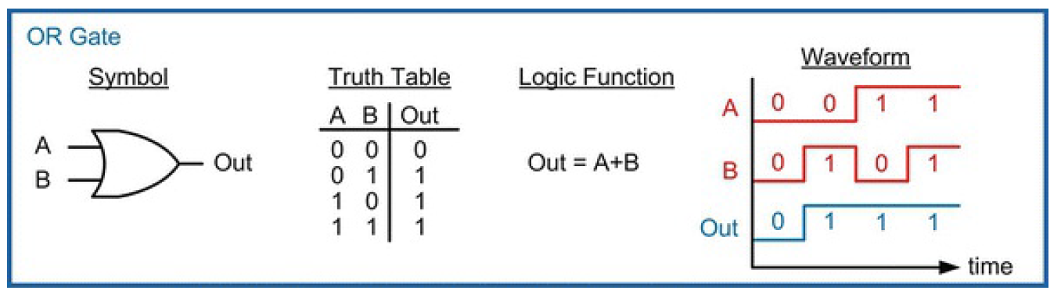
OR Gate
The OR gate produces a TRUE output, Y, if either A or B (or both) are TRUE
Also called a logical sum because of its similarity to logical disjunction in which the output is true if at least one of the inputs is true

Slide 9
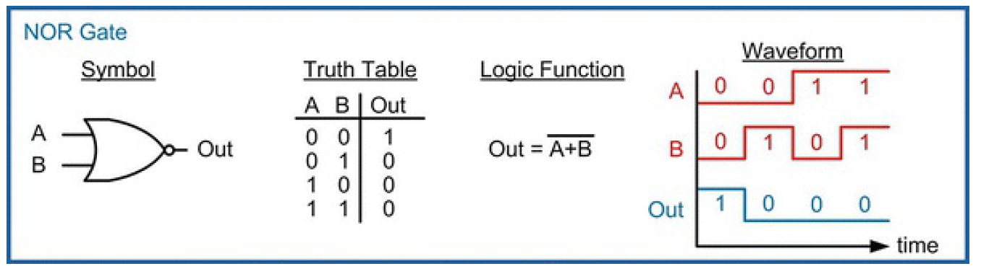
NOR Gate
NOR gate is identical to the OR gate with the exception that the output is inverted.
The symbol for a NOR gate is an OR gate with an inversion bubble on the output.
The logic expression for a NOR gate is the same as an OR gate, but with an inversion bar over the entire operation.

Slide 10
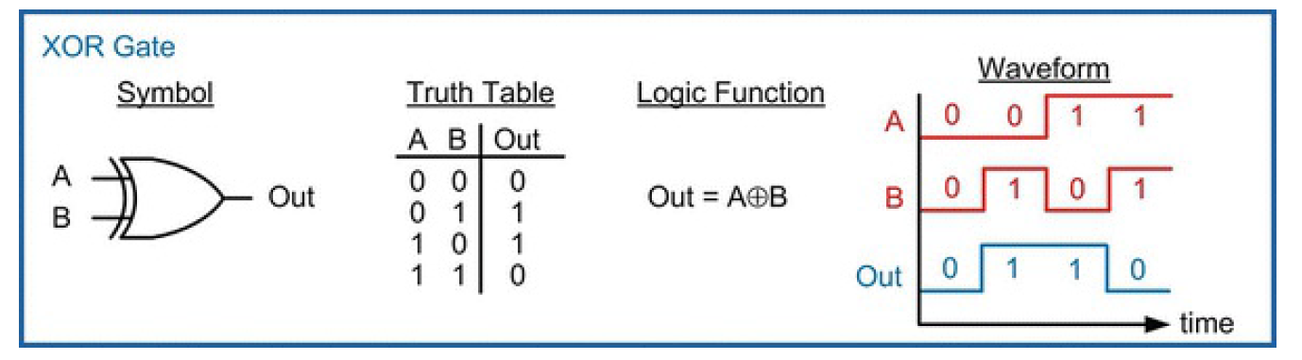
XOR Gate (exclusive-OR gate)
Also called a difference gate because for the 2-input configuration, its output will be true when the input codes are different from one another.
XOR (exclusive OR is TRUE if A or B, but not both, are TRUE.
True when there is an ODD number of 1’s on the inputs

Slide 11
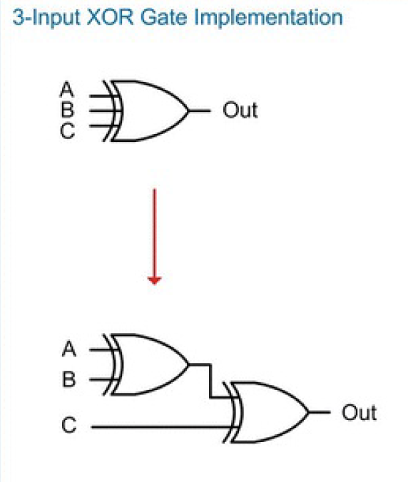
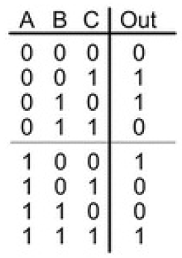
XOR Gate (exclusive-OR gate)

Slide 12
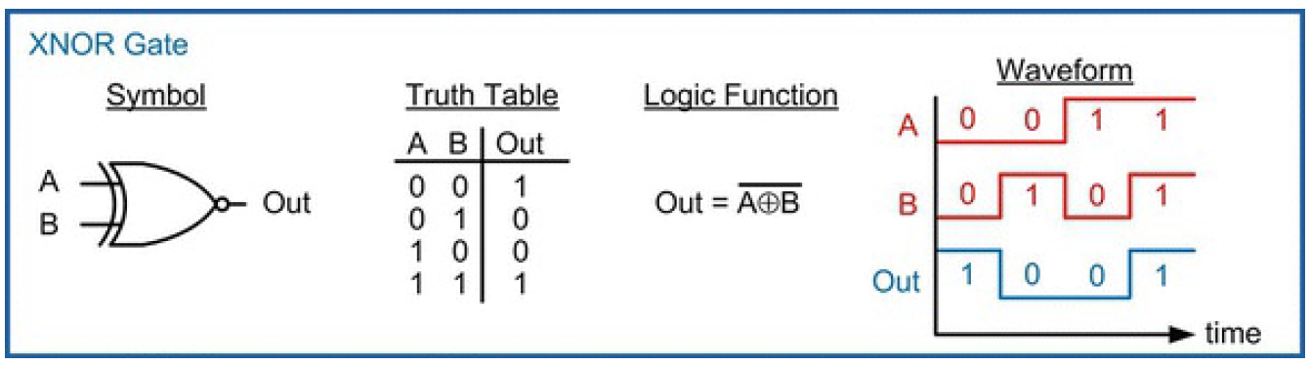
XNOR Gate (Equality gate)
Identical to the XOR gate, with the exception that the output is inverted.
This gate is also called an equivalence gate because for the 2-input configuration, its output will be true when the input codes are equivalent to one another.
Output is true if there is an ODD number of 1’s on the inputs

Slide 13
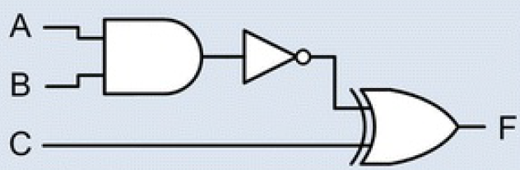

Given the following logic diagram, which is the correct logic expression for F?

Slide 14
Multiple-Input Logic Gates
Truth table rows
are listed in
binary order.
Multi-input XOR: Odd parity

